Slide 1
Engaging and Communicating with Individuals with Autism before, during and after the Intake Process through Eligibility Determination
Mary Baker-Ericzen, PhD
WINTAC
Interwork Institute, SDSU
Notes:
Welcome everyone. I am Dr. Mary Baker-Ericzen an autism spectrum specialist and trainer at WINTAC . I am also a Research Scientist at the Interwork Institute at SDSU and a practicing Clinical Psychologist at the Intricate Mind institute in San Diego, Ca. I have worked with individuals with autism for about 30 years now and counting!
I am thrilled to be presenting this second webinar in our new series of webinars specific to understanding and working with individuals with autism spectrum conditions. If you have not viewed the first Webinar titled, “Understanding Individuals with Autism Spectrum conditions within Vocational Rehabilitation Services” that may be of interest to you as well and I recommend viewing it.

Slide 2
Agenda
Quick overview of data on employment in individuals with Autism Spectrum Diagnoses (ASD)
Current state of VR services and ASD
ASD features and enrollment into VR
Adjustments for engaging with autistic individuals
Communication Style
Sensory Supportive Environments
Awareness of Social and Other Anxieties
Addressing Executive Functioning Challenges
Utilizing and supporting strengths and special interests
San Diego example- brochure method
Promoting community outreach and access
Notes:
This webinar is particularly focused on the entire process of enrollment of individuals with ASD in VR services including improving community outreach and access all the way through to engaging with individuals within the intake process for eligibility. I will provide some background and overview of data specific to those with autism including the continuous increases in prevalence, increases in numbers served by VR over time and some information on the most up to date data and who is being served. I wanted to state that there is appreciation for both person-first and identity-first language in this population so I will be interchanging use of terms as Autism Spectrum condition, Autism Spectrum Diagnoses or ASD and autistic. Autism Spectrum in this talk today will include those who identify with autism, Asperger’s and Pervasive developmental disorder as well Aspie and Autistic (not considering it as a disorder or condition). So to be respectful to all multiple terms will be used interchangeably.
I will also spend ample time on how to adjust your interaction style and setting to engage and connect more successfully with those with autism. I will focus on individuals’ strengths and special interests and provide you with an example from San Diego on how these have started to be implemented and specifically the use of brochure developed for AS population as a way of integrating outreach and access with engagement and enrollment procedures.

Slide 3
Background of Employment for Autism Spectrum Folks
Unemployment and underemployment continue to be profound problems experienced among individuals with ASD, starting in the transition age and continuing through adulthood
In 2014, the Workforce Innovation and Opportunity Act (WIOA) updated the legal framework for the federal Vocational Rehabilitation (VR) program in the US specifically to increase opportunities for individuals with disabilities, including Transition Age Youth (TAY), to find and maintain employment.
Of the 51 state plans, 44 contained references to autism, and 19 explicitly identified autism as a disability group that is underserved by the state VR agency. (Roux, Garfield, Shattuck, 2019)
Research group analyzed WIOA FFY 2016 Unified and Combined State Plans for all 50 states and the District of Columbia published at rsa.ed.gov, - 53% identified a need for autism-specific training and/or currently provided autism training of some type
However, no innovations were found that focused on communication about the availability of VR services for individuals with autism or methods to influence uptake of VR services in this population.
Autism-specific VR strategies, goals, and services appear to be the exception – not the norm, at least in terms of what is documented within WIOA state plans.
(Roux, Garfield & Stattuck, 2019)
Notes:
As many of you have probably learned by now the employment rate for people with autism is between 50%-75% lower than that for people with intellectual disability without autism and nearly all other populations with special needs.1-7 It is estimated that overall only about 15% of adults with autism spectrum conditions are working. Of those who are working majority of them are underemployed meaning they are working in a work setting that is not capitalizing on their skills and abilities and/or working far less than optimal hours.
Now remember that in 2014 the WIOA ….(read slides)

Slide 4
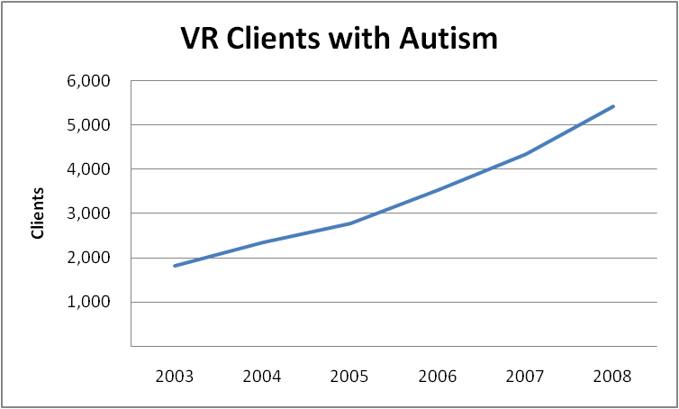
The Great Wave
Data from Rehabilitation Services Administration
Nationally, people with autism applying for VR services increased 300% from 2003 to 2008 and about another 300% from 2009-2014
2015 nearly 18,000 VR cases of youth and adults with ASD closed – doubling the 9,000 cases closed in FFY 2010
National Autism Indicators Report: Vocational Rehabilitation – 2016
Notes:
Now, in looking at the data over the past 2 decades from U.S. Department of Education’s Rehabilitation Service Administration Case Service Report (RSA-911) data across all states we see a very similar trend or is often referred to as the “Great Wave” or “Autism tsunami” as the prevalence for this condition continues to rise overtime and the children continue to age. When I speak to community groups and at conferences I usually like to state that we have Finally found 1 symptom that all children have who have autism----aging!
So you can see the trend lines have continued with large increases and all current data suggests the same. So our VR services are still at the early stages of serving the autism population and we will also continue to see yearly increases in numbers. There are currently no signs of flattening the curve or a plateau effect.
According to the U.S. Department of Education, from 1996 to 2005 there were huge increases of children identified with Autism Spectrum conditions
6–11 years old increased by 410 %,
14–17 years old increased by 514 %
18-21 years old increased by 317 %
Increase due to transition students (up to 40%)
2003 is ten years after the beginning of IDEA data
37% of states indicate autism as a currently underserved population

Slide 5
IN Fact
Every year there are about 50,000 youth with ASD turning 18 yrs
Majority (85 %) of people with ASD who sought services were between 16 and 26 years old.
Research showed that it took a significantly longer time for the transition youth to move from application to eligibility determination for VR services
(Migliore et al., 2014; Chen, Sung & Pi, 2015)
Notes:
In fact we continue to have about 50,000 autistic youth turn 18 yrs old per year and with WIOA the majority of those seeking VR services and becoming new enrollees are between 16-26 years old. Interestingly, an important piece of information from these studies showed that it is taking a significantly longer amount of time for these transition age youth to move from application to eligibility determination of VR services. However, we don’t have much information on the WHY to this occurrence at this time. This is definitely an area for taking note and further study.

Slide 6
VR Services and Autism Spectrum Disorders
Most services were provided by community rehabilitation programs under contract with VR.
Assessment was the most common service used by those with autism
Roux, Anne M., Rast, Jessica E., Anderson, K.A., and Shattuck, Paul T. National Autism Indicators Report: Vocational Rehabilitation. Philadelphia, PA: Life Course Outcomes Research Program, A.J. Drexel Autism Institute, Drexel University, 2016.
Only 3% of VR applicants found eligible have ASD
Only 32% of those with ASD
USE VR services after becoming eligible
46% were ASD High School students when received services
Notes:
So what do we know about VR services and ASD.
RSA Data from FY 2014-2016 was carefully exampled by the folks at Drexel University- Anne Roux, Paul Shattuck and colleagues.
Individuals on the autism spectrum who received VR services comprised 3% of all VR service users, while those with ID made up 9% of VR service users. Range of states is 1% (South Carolina, Mississippi, New Mexico, District of Columbia) to 8% (Minnesota)
• 32% used VR services and across state ranged from 39% (North dackota) to 88% (Pennsylvania). VR service users with autism were more likely to be male, White, and younger, compared to their peers with ID or other types of disabilities.
• 46% were secondary students with across state range of 0% (New Jersey) to 73% (Arizona).
Approximately two-thirds of autism applicants deemed eligible received VR services - the same rate as those with ID.
For example, states are currently designing pre-employment transition services (PETS). It will be important to measure the impact of these efforts and whether new state policies and programs begin to move the needle on employment outcomes for those with autism and other disabilities.

Slide 7
Referrals into VR for ASD
(N = 5681)
Source of referral | Transition Age Youth (<18 yrs) (n = 2718) | Transition Young Adults (18-25) (n = 2162) | Adults (26+) (n = 801)
Educational institution | 2180 (80.2 %) | 737 (34.1 %) | 17 (2.1 %)
Public or private service agency | 112 (4.1 %) | 368 (17.0 %) | 229 (28.6 %)
Self-referral | 152 (5.6 %) | 525 (24.3 %) | 308 (38.5 %)
Others | 274 (10.1 %) | 532 (24.6 %) | 247 (30.8 %)
Chen, Sung & Pi, 2015
Notes:
Chen, Sung and Pi conducted research with the RSA-911 dataset and specifically examined referral sources into VR services for ASD. You can see in their sample there were substantially more TAY so that the group was broken down further into those likely to still be in school <18 yrs and those that are more likely to be out of school 18-25. This data shows how valuable a direct referral source like an educational institution is to access to care. Adults who may have missed being referred by their high school or post-secondary educational setting are less likely to be informed about VR services and proceed towards enrollment reducing overall access to care.

Slide 8
Other Enrollment Issue: Homogeneity
Notes:
Data is also revealing that autistic individuals that do pursue VR services and complete intake and eligibility procedures and become service users are far more likely to be White, young (again likely being enrolled in HS setting) and less likely to have had any postsecondary education at time of VR service use compared to VR service users without autism. Again this is showing access issues and challenges with enrolling diverse populations including those that are more middle age adults. Our own local data from community members revealed that the autism population were either 1) unaware of VR and available services or 2) feeling that they were not supportive of their needs. Many autistic individuals and family members shared with us stories about the problems with the current VR eligibility process starting with need to self-initiatie and attend an orientation offered in a large, over-stimulating environment with a large group of people (often 50-100) in which they walked out and stopped the process.

Slide 9
Intake Process
Engaging and enrolling individuals with ASD merit special attention because of the social-cognitive, behavioral, and communication impairments associated with ASD
Concrete, literal communication styles
Sensory sensitivities
Social and other anxieties
Lack of initiative
Time management and organization challenges
Reliance on routines
Coupled with strengths in memory, focus, and in-depth knowledge of special interest areas
Detail-oriented
Strong memories
Logical and creative thinkers
Amazing skills for Special Interests
Notes:
I wanted to start off with a couple quotes taken from an article in Autism Spectrum News entitled Improving Vocational Rehabilitation Services for Adults with ASD
By: Yvona Fast, an autistic self-advocate written in November, 2019
VR professionals “need to know that a person can go to college, achieve a degree (or two) and still have difficulty with specific tasks required for work. They need to understand that all people with ASD are different. Many are visual learners who, like Sheldan, can benefit from shadowing programs. Others don’t learn by observation and need specific, detailed instructions to carry out a task.”
“The most important thing to realize is that these individuals process information differently. They can be easily overwhelmed by too much information, and find many things about job hunting and the workplace confusing. These are concrete, literal thinkers who focus on details and require explicit instruction and examples. You cannot presume that they understand what a job really entails just from reviewing a post, or that they can apply information they read to their particular situation. If tasks aren’t completed, it may be that the steps are too big, or that the individual doesn’t know how to begin. The person might be too anxious to make telephone calls or visit a company to fill out a job application.”
That article was so consistent with what we have experienced and that our community population has communicated to us over and over which is that the VR process is not YET welcoming to ASD community. I emphasize the word YET as this is a very general statement and there are many individual examples across states or within states, within agencies, within people that already started to make adjustments to fit autism needs. Now for those who can benefit learning more and moving forward on the process of making adjustments lets get started. First you will note that recommendations for adjustments will be presented at what might be considered multiple ways or levels. They will include system level changes, provider level changes and setting/environmental changes. What I will be discussing moving forward is meant to increase knowledge and information of ASD but more importantly to be fuel for further thought- that can lead to localized changes and personal changes. Much of these recommendations comes more from experiences then research.
So let’s get started. As was explained in much more depth in the first webinar those with ASD have special needs to attend to that are related to social-cognitive, behavioral and communication differences. In sum, typically they use a more concrete literal communication styles. They have unique sensory sensitivities to any or many of the 5 senses. They often have anxieties that may be social anxiety and/or specific or general types. Often they struggle with taking initiative including making calls or showing up to an event based on a flyer. They can have many challenges with time management and organization such as not using calendar systems to know when to attend a meeting. There is also a reliance on routines resulting in concern when a routine needs to be changed to attend a meeting or event and not having subsent meetings established on a routine type schedule.
Autistic individuals also are often described as having splintered skills. This means there can be issues as named above that substantially impacts their ability to work and function independently but at the same time have high abilities in other areas. These are often related to their specific interests- called special interests. They also may be more general like being detail-oriented or have strong memory (visual or auditory..give examples). Their brains more typically process information in logical ways. They may link information together with their own creative associations. They may “see things differently” or “think outside of the box” also resulting in high levels of creativity. This can manifest in various ways as art, music, computer programming, analytics , writing, design or even organization skills.

Slide 10
Communication Style
Adjust Communication Style
Be mindful of language (say what you mean and mean what you say).
Be explicit about what type of information you are asking for.
Ask many direct questions.
Wait up to 10 seconds for a response.
Provide feedback, especially reinforcement, during the conversation.
Prompt for additional information to understand their perspective. (i.e. Tell me what you mean…)
Use “Think Aloud” to communicate what you’re thinking and/or feeling
Demonstrate- model, role-play, video-modeling.
Assume Nothing; Explain Everything!
Notes:
So let’s start with Communication Style. There are a number of adjustments that you can make to more fully engage and communicate successfully with those with autism.
Go through slide and provide examples for each.
Watch out for figurative language like idioms, methaphors, etc.
they need very specific, detailed, clearly spelled out expectations.

Slide 11
Sensory Supportive Environment
Environmental Adjustments
Prepare for each meeting with agenda and written questions and/or visuals.
Avoid meeting in or near higher odor environments- breakrooms/cafeterias, cologne/perfumes, air fresheners/essential oil infusers etc.
Offer only handshake (may not be received) and no other physical touch (i.e. shoulder/arm touch).
Provide fidget items and moving chairs (i.e. swivel type).
Use increased social distance (1.5-2 arm distance rule) during all interactions.
Be aware of external noises/sounds and close windows or doors to reduce.
Ask about comfort with fluorescent lighting or high natural light areas.
Notes:
Environmental supports are key in maximizing the functioning of people with ASD. You will need to ask some direct questions, carefully observe and make some smart guesses about helpful environmental adjustments until you get to know the consumer more through the intake process. Here are some common changes to make.
Go through slide and provide examples of each.

Slide 12
Social and Other Anxieties
Attend to Common Anxieties
Provide information in advance (written and visual forms preferred).
Be explicit about what will take place during each interaction.
Prime for all that is new (people, places, activities).
Allow for comfort items.
Slow down pacing and provide increased processing time.
Provide encouragement and praise.
Establish familiarity and minimize change.
Be aware that anxiety can look like “attitude problems”, “uncooperative” or “behaviors”
Notes:
Anxiety is a very common co-occurring issue for those with ASD. Research shows rates between 60-85% of individuals with ASD demonstrate significant level of anxiety in one or more areas. Certainly social anxiety is highly common but so is a more generalized anxiety condition. Newness can cause anxious reactions so as much preparations, priming and advanced notices of changes can be very meaningful adjustments.
Go through slide and give examples of each.

Slide 13
Supporting Social Uniqueness
Offer Social Supports
Be open-minded about social expectations.
Be mindful about own interpretations and taking communication faux pas or blunders personally.
Understand that sufficient social abilities in eligibility meetings is not predictor of employment and service needs.
Acknowledge the value of supportive people or even animals or objects for the individual.
Social conventions may not be demonstrated.
Social challenges may be the factor and NOT motivation.
Notes:
Autistic Individual may not want to shake your hand, look you in the eye or posture themselves towards you. These unique social forms are not to be interpreted as abilities or intellect. They also should not be interpreted as motivation issues. Social awkwardness, mishaps and misuses are part of the condition. It may also be related to anxiety.
In general, in order to qualify for services, OVR must determine that:
You have a physical or mental disability;
Your disability causes a barrier to employment;
You have the ability to benefit from services to prepare for, obtain, or retain employment; and
You want to work.
Certainly social challenges is related to their disability and causes a barrier to employment. Be careful to not interpret lack of social graces as poor motivation or disinterest in wanting to work. Ask those types of questions directly and remember… assume nothing.
Read through slide and provide examples.

Slide 14
Executive Functioning Challenges
Accommodate Executive Functioning Deficits
Require proactive contacts for all VR related activities.
Need for prospective memory supports as email or text reminders, calendar invites, and prompted calendar app use.
Create routines for meetings and VR activities (same day, same time, same place).
Prompt use of note-taking, calendar use and to-do-list in the moment.
State aloud what should be written down. Provide information in steps (1. 2. 3.).
Request directives be repeated (to ensure accurate attention and encoding of information).
Be aware that EF problems often look like “motivational issues” or “behavior problems”.
Notes:
Often their executive functioning challenges can make it hard to even complete and turn in the application or complete the first tasks in the intake towards eligibility like show up at the right day and time to attend an orientation. Or to take initiative and call the VR offices to schedule an intake meeting.
Read through slides and provide examples.
Be mindful of jobs that are dependent on speed, required the ability to multi-task and the ability to think on one’s feet. (like in food industry).

Slide 15
Gathering information about Special Interests and Talents
Obtaining Information on Strengths
Need to ask directly.
Observe personal items for themes.
Inquire about how time is spent each day.
Allow one-way discussions to gather more details.
Think creatively how special interests relate to employment options.
Identify skills sets related to special interest activities.
Notes:
Matching the interests, skills and strengths of an autistic person with a particular job will improve outcomes.
However, it is not always easy to learn and understand their strengths and special interests. Individuals with autism are sometimes unknowing themselves that their interests are “special interests” and strengths. They are not always aware that they know so much more about a topic than others or are really good at a certain skill. They just do it. Sometimes just in their free time, alone, because they like it and not evaluating their own ability. So it can take effort to learn what these are.
Read slide and provide examples.
Watch out for placing autistic people in unskilled, entry-level jobs, rather than jobs commensurate with the person’s educational achievement.
Steve describes his experience with the state VR Office: “They would help me look in the classifieds and send resumes to different places. It was kind of bizarre that, for three years, they kept asking me what type of job I was looking for!” He had a few interviews, but with meager results. Finally they said his time was up. (From Autism Spectrum News article by Improving Vocational Rehabilitation Services for Adults with ASD
By: Yvona Fast, MLS GRASP, November 5th, 2019).

Slide 16
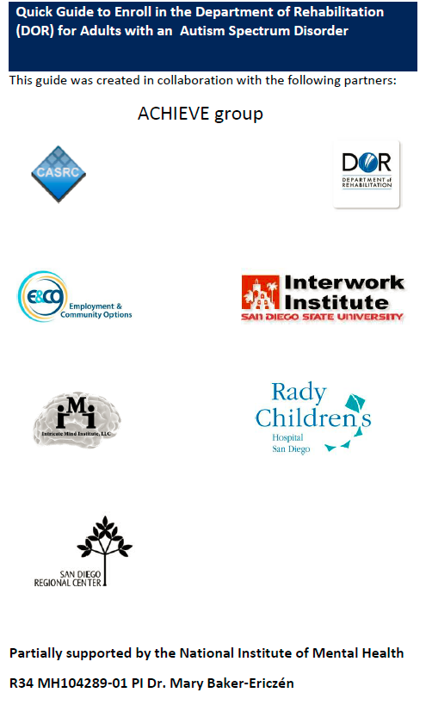
San Diego Example: VR Enrollment Guide
Notes:
So let me share with you some active changes San Diego has done as a result from an active research-community partnership called ACHIEVE. ACHIEVE stands for Active Community Hub for Individuals with Autism to Enhance Vocation and Education. It is a dedicate group of community stakeholders including research team Led by myself and Drs. Caren Sax and Lauren Brookman-Frazee along with VR administrators, vocational agency leaders, disability services administrators, educators/professors and disability counselors, family members, and autistic self-advocates and transition age youth with autism.
This group identified a need in our community to provide a more welcoming enrollment environment into VR for the autism community. Many reported not making it to eligibility due to a number of barriers related to what was discussed already like being overwhelmed at the orientation, or not being able to initiative phone calls to VR counselor or not understanding how to communicate needs and being told they didn’t qualify even though they have been out of work for years or never had a job outside of what was given to them by their family. Many community members indicated they didn’t even know what VR did.
So how community 1st created an “enrollment guide” brochure for ASD. It was a full community effort!

Slide 17
San Diego Example: VR Enrollment Guide
Notes:
We designed it as Steps so that it was clear what was needed to be done as their part. We provided scripts to guide them on what to say. Providing preparation and priming them for what would happen throughout the process. There was effort to balance providing details for them but not too many to appear overwhelming. We received a lot of feedback from our community partners about this balances. Our autistic members and family members mentioned frequently about feeling overloaded by the information. We used colors and font changes as visuals to help break up the information and to provide emphasis. We learned it was important to prepare them for the type of information they would need to share as many felt it was invasive when the intake counselor asked those questions when they weren’t prepared that it would occur.
We learned that individuals with autism were often unprepared during the intake meeting which resulted in frustrations by both VR staff and the individual with autism. So we gave specific directives in Step2 and Step 3. They also often did not clearly communicate what their challenges were in working and too often were not found eligible for services at the most correct level for their needs. It is more comfortable to share abilities so that the areas of need and challenges, that are anxiety provoking for them, were avoided. So we made that aspect more explicit and set the expectation that these weaknesses (preferred wording from out autistic partners) should be discussed.

Slide 18
San Diego Example: VR Enrollment Guide
Notes:
We also learned that they often did not have the language to describe their challenges/weaknesses and when they did were a bit “all over the map” when stating them so it was difficult for intake counselor to have clarity. So we provided some organization to their areas of need and gave some language. It is much easier for the AS brain to recognize a concept then to generate it. It also was a way for them to gather information from others who know them well and to have that information coalesced into 1 document and in 1 location. Again it was a difficult balance of being comprehensive but manageable. Creating this list took many meetings!

Slide 19
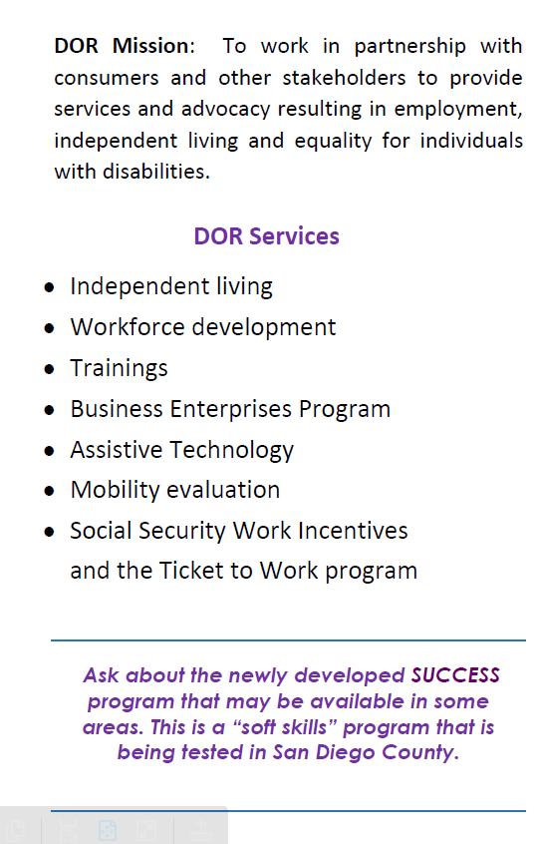
San Diego Example: VR Enrollment Guide
Notes:
Final pages of the brochure included a section on Helpful Tips and providing specific information explaining what Dept of Rehabilitation (DOR is acronym in California) does and services it offers. This was necessary as tour community group indicated that very few individuals and families understand the adult service system. This is improving greatly each year and especially now with the focus on enrolling in VR while in HS through the targeting of transition age youth.
The helpful tips was an opportunity to make other expectations explicit and to explain the process further. We explicitly state that parents or other support persons are welcome during intake appointment. In fact we found that it was VERY helpful to have a support person like that there to provide additional information and to provide more communication. Sometimes adults with autism might think literally and that they need to go alone. We even learned of parents sitting in the car and waiting instead of joining the meeting. Individuals with autism shared with us that they were concerned about providing personal information to people they didn’t know so we explicitly stated information is CONFIDENTIAL (again using visual colors and font to help attend and remember the info). We learned that counselors weren’t asking specifically of the person had autism so then it was being stated by the individual. Again due to perspective-taking challenges this population does not know how to anticipate or predict what information is needed or helpful and it needs to be directly asked! We learned that the individual was being asked novel types of questions so responding with I Don’t know and that there was not enough guidance and time to think it through so lots of information was being missed or skipped over. We specifically addressed the sensory overload issue of the orientation that was a major barrier to pass for a large proportion of ASD population. These tips also help remind the intake counselor of the unique needs of autism and prompts them to think about communication, social, sensory and EF issues as well.
Try to end on a positive, empowering note to promote some motivation. ☺
Last a common list of services is made available and a plug for other possible related intervention that may be meaningful to them the SUCCESS vocational soft skills training program. That will be presented in a future webinar.

Slide 20
Addressing Community Access
Notes:
To now focus a bit on addressing the community access issue. Remember that the autism population within VR services across the nation is too homogeneous in regards to demographic characteristics. This is indicating an awareness and access issue. Brochures like the one that San Diego developed may be of value in increasing awareness and access. There are probably other necessary efforts as well. Unfortunately we have little research or data on HOW to do this.

Slide 21
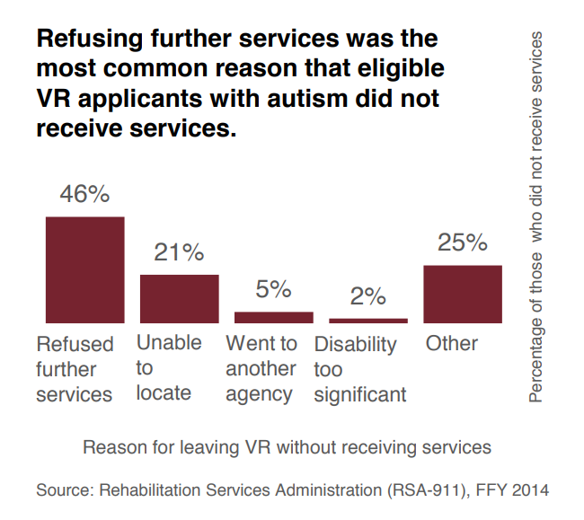
Additional Access Barriers Identified
Notes:
VR counselors assign two codes for the type of disability a person has—an impairment (reason that employment is difficult) and a cause (the underlying condition that causes the impairment). Here we see the impairment reasons for the autism population with autism being identified as the primary or secondary cause. The majority have cognitive or psychosocial impairment. That is consistent with the AS diagnosis. Now low at what happens after made eligible for services. A large percent are refusing further services. Unfortunately his is quantitative data from records so we don’t know the WHY exactly, but qualitative study from our local area in San Diego as well as some initial reports from other areas are indicating that the AS population is not finding the services of assignments to apply to jobs, attend workshops and send emails updating the counselor as helpful.
This leads us all to call of action to not only understand these “drop outs” further but to also make some system changes in providing services truly matched to ASD. It will take creative thinking and borrowing from other successful models.

Slide 22
Novel Enrollment of Diverse Autistics
Marketing Services- Enrollment Guides, Video-Game Expos
Welcoming Environments- Mobile Meetings
Engagement with Community- Religious Groups, Healthcare Clinics, ABA Providers, Parks and Recreation Programs
Notes:
Here are few creative and interesting ideas. Spending more time and efforts in marketing VR to this community. Using enrollment guides like we did in San Diego may be one approach. Another approach could be borrowed from the military. As San Diego is quite a large military recruitment hub as we have Navy, Airforce, and Marines bases I have learned about new method they are using for marketing and recruitment. They are hosting video-game expos and allowing folks to come try to releases of video games and also talk to recruiters and learn more information on site. Now the AS population typically loves gaming….
Other ideas for creating welcoming environments maybe to borrow methods from child welfare settings is to be more mobile. Mobile intake meetings at the location the individual is comfortable at- home, community group. It is basically what is being done at schools with TAY group and it’s working!
Last might be engaging with community groups more. Places where we know these individuals are participating. What else can you think of? Be creative, innovative and let’s establish some new models and systems!

Slide 23
Plug for Upcoming Webinars
Notes:
To end I have provided some disappointing data on what the ASD population is currently accessing and doing. Here you can see that only a few are employed. Most live at home. ¼ are uninsured. Only about 1/3 receive social security income. Taken together this population is in poverty with little public services and at home without work in the community.

Slide 24
Coming SOON!!
Autism focused series of trainings to help VR counselors work with individuals with autism through all phases of the rehabilitation process.
Topics Include:
Tailoring assessments and Individualized Plan for Employment (IPE) process for Consumers with Autism
Interventions, Services, Supports and Accommodations for Individuals with Autism to enhance Competitive Integrated Employment (CIE) outcomes
Notes:
Which leads us to our next 2 webinar topics for this series to continue to understand and impact the autism population.
Read slide topics.

Slide 25
The End
THANK YOU!!!!
Dr. Mary Baker-Ericzen can be reached at mbakerericzen@sdsu.edu

